Slide 1
Progress Presentation
Maura van der Linden, Lars Zandbergen, Qi Draaisma, Franklin Willemen & Celena Jordaan

Slide 2
Contents
Our Project
Vision
Terminology
Progress
Burndown
Second sprint

Slide 3
Our project
Entrepreneur Challenge
Profitable Website

Slide 4


Vision
What: Artificial Intelligence project platform.
Who: AI Start-ups and students.
Why: One platform where AI talent and projects come together.

Slide 5
Terminology
SEO: Search Engine Optimization
Growing quantity & quality of website traffic
Increasing visibility of website for users web search engines
Adsense
Program run by Google
Advertisements that are targeted to the site content and audience
Generate income

Slide 6
First sprint
Sprint 1 high level:
Working website
Blog posts
Using SEO & Adsense
In progress:
SEO on posts
Adsense
Notes:
Now that our first sprint has almost ended, I will discuss the progress we made during this sprint with you. At a high level we planned to have a working website at the end of this sprint. We should have our own domain and the website should contain a couple of pages as stated in our sprint backlog. Secondly we wanted to have our first blogs onto our website. We also wanted, as the requirement of our project stated, to use SEO in our blogposts en website. Lastly our site should work with adsense which means that visitors can see advertisements on our site. We did not yet finished all of the requirements for our first sprint backlog. The adsense on our website doesn’t work yet, but alsmot all of the preparations for this are done. Besides this we don’t yet finished the SEO on all the post, but this is more of a continuing process during our project. Now you know our higher level ideas of the first sprint I’ll show you what is look like on the sprint backlog.

Slide 7
Notes:
Changed our focus from freelancers to AI students
Green is done and yellow is still in progress

Slide 8
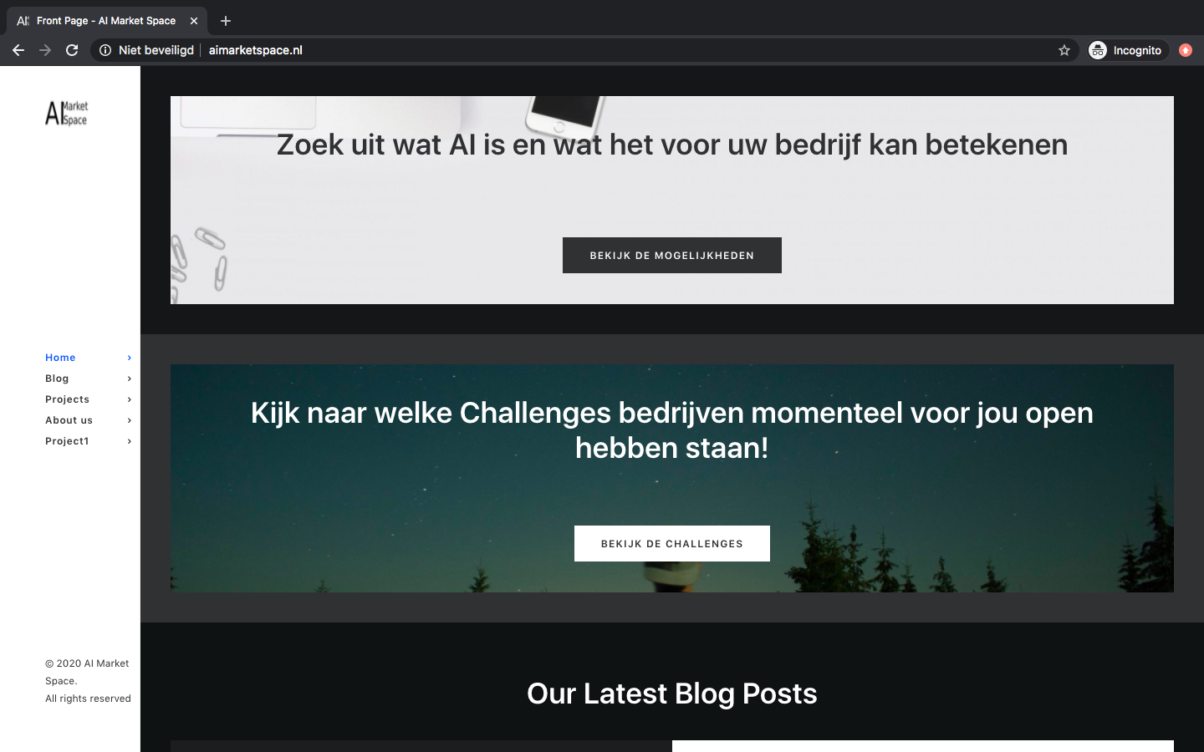
So what does that look like?

Slide 9
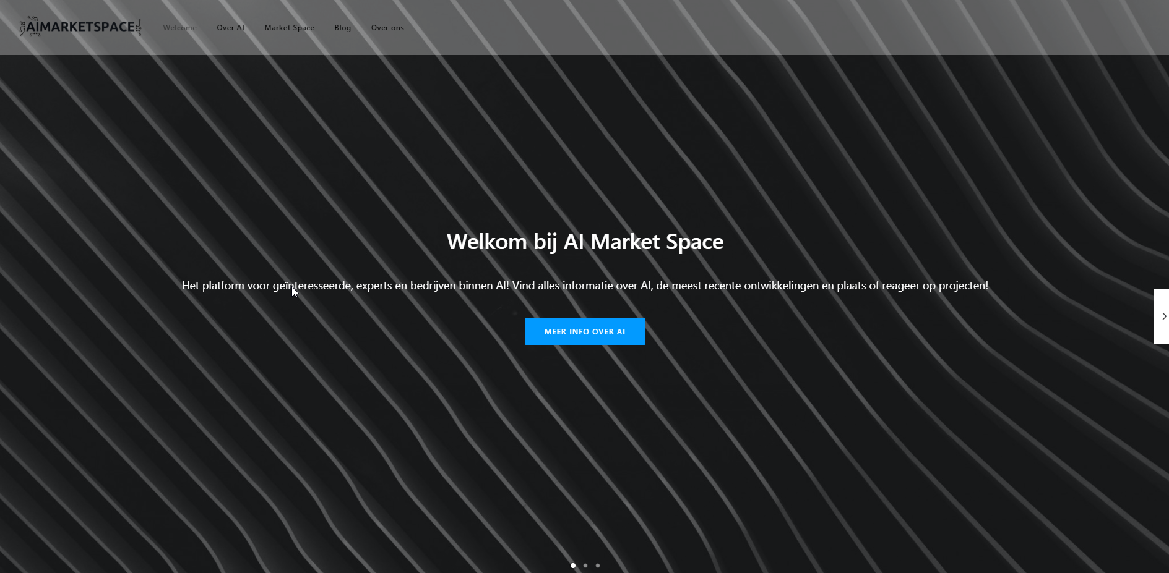

Slide 10
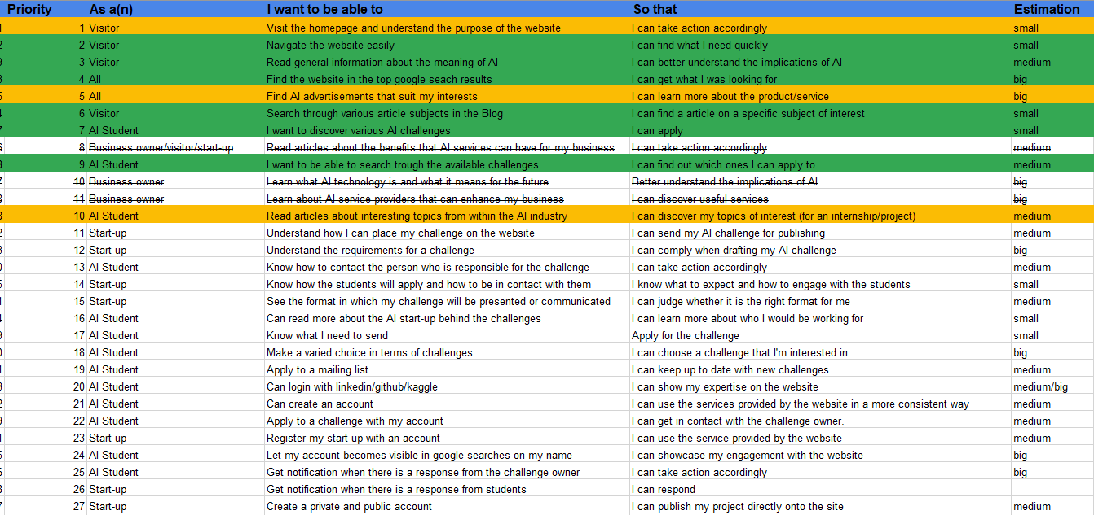
Product Backlog after Sprint 1

Slide 11
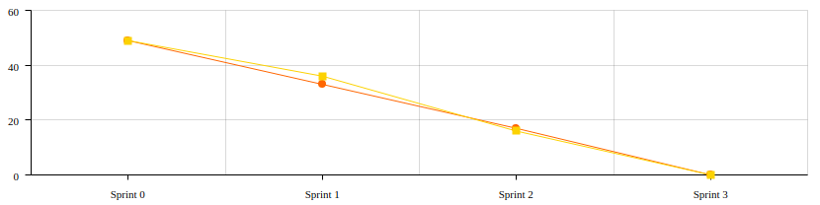
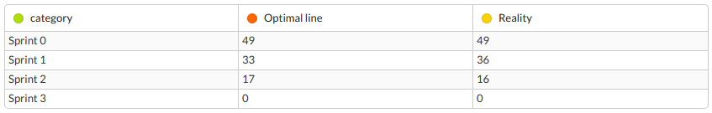
Burndown (Project)
Notes:
Products, not UvA related work
Behind? Because we are ambitious! Nothing too hard to handle!

Slide 12
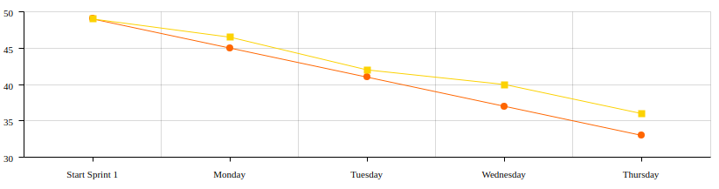
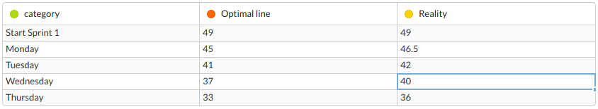
Burndown (Sprint 1)

Slide 13

Second Sprint
Ongoing: - Website improvements - Writing articles
Sprint 2 high level: - Communication - AI challenges - Business
Deliverables: - Business ready website - Communication and business protocol - AI challenges
Notes:
Website improvements: Design, information. Writing articles: Writing content focused on students. Communication: Start-ups, Students. AI challenges: Projects, Internships, Jobs. Business: SEO, Adsense, Business model overall. Business ready website: Challenge overview and page done. Communication and business protocol: Formalize strategy regarding communication and business practices. AI challenges: Generate leads, be in contact with various start-ups

Slide 14
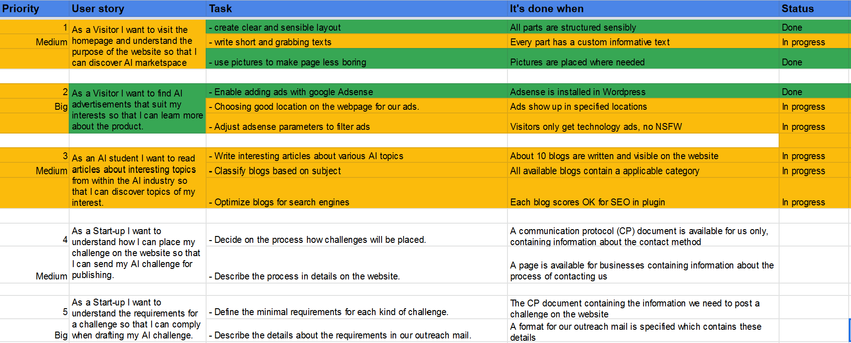
Sprint 2 backlog
Notes:
We prioritized the ongoing user stories because they are the base of our product. (Yellow)
Priority 4 - 12 are the stories w.r.t. our deliverables for sprint 2

Slide 15
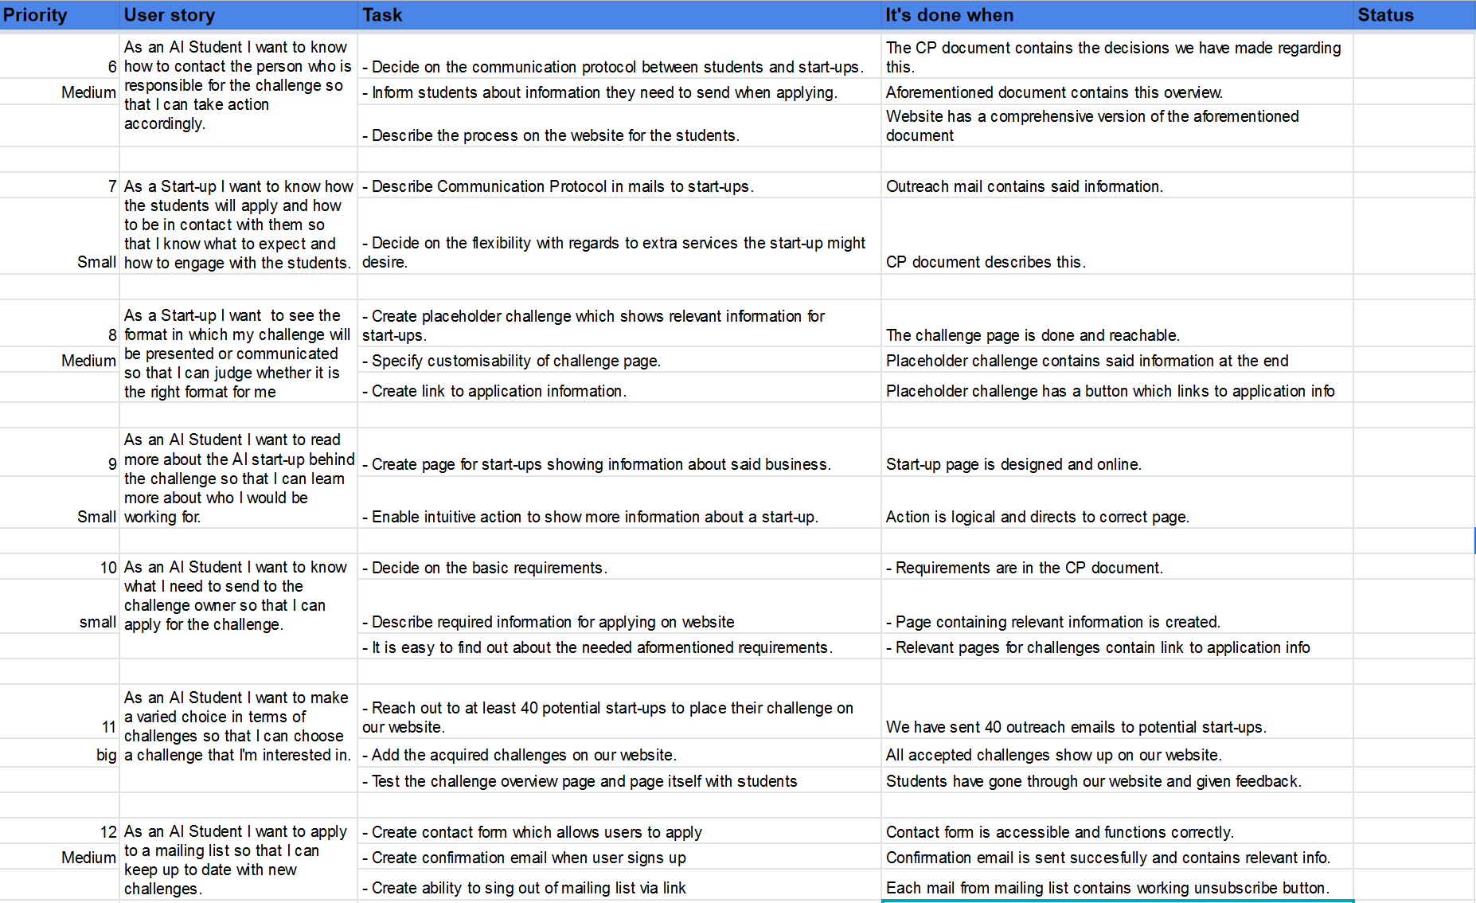
Notes:
While executing these stories we expect new stories to pop up as it is a “Rich” sprint.

